Slide 1
Graphs - Algorithms and Mining
(DSE** ZG521)

Slide 2
Module I

Slide 3
Course Introduction
COURSE Objectives:
  CO₁: To introduce handling graph data at large scale
  CO₂: To introduce graph mining algorithms and their applications
  CO₃: To enable students to identify and formulate graph mining problems formally, providing solutions
  CO₄: To enable students to evaluate various possible graph mining solutions for a given problem

Slide 4
Resources
TEXT BOOKS (T1 & T2):
Social Media Mining - An introduction, Reza Zafarani, Mohammad Ali Abbasi, Huan Liu , Cambridge University Press , 2014 [ http://dmml.asu.edu/smm/SMM.pdf - Open Access]
Not all topics are covered in one text/reference book.
* Research Papers will be used for most of the topics.
* Most of the contents are theoretical, but their practical application will be explained.
* Research Paper will also be provided to you, for your better understanding

Slide 5
Resources
REFERENCE BOOKS (R):
(R1) Agarwal Charu C. and Wang Haixun, “Managing and Mining Graph Data” , Springer; 2010 edition.
(R2) Jure Leskovec, Anand Rajaraman, Jeff Ullman. “Mining of Massive Datasets”. Book 2nd edition. Cambridge University Press.
(R3) Tan P. N., Steinbach M & Kumar V. “Introduction to Data Mining” Pearson Education, 2006

Slide 6
EVALUATION SCHEME
EC No | Component & Nature | Duration | Weightage | Date, Time
1. | Quiz 1 | - | 5% (Best of the Two)
1. | Quiz 2 | -
1. | Assignment 1 | - | 25%
2. | Mid-Semester Test (Closed Book) | 2 hours | 30%
3. | Comprehensive Exam (Open Book) | 3 hours | 40%

Slide 7
Few Requests
Email etiquettes.
No “reply to all”; unless & until unavoidable!
No Request to timeline extension, with the reason of being working professionals.
Continuous reading of papers & books.

Slide 8
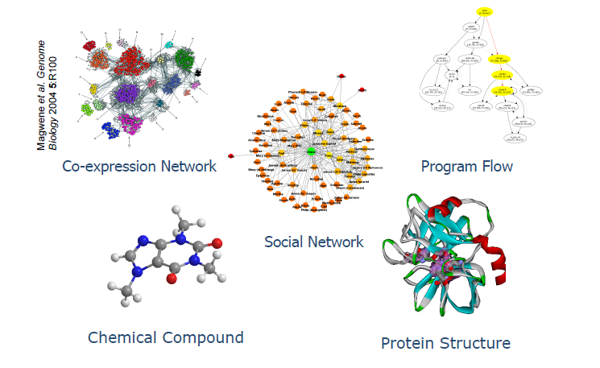
Various type of Graph Data for Graph Mining

Slide 9
Course Outline
Introduction to the Graphs
  Preliminaries
Graph Mining Applications
Overview of Graph mining Algorithms
  Graph Data Management Algorithms
    Indexing
    Querying
      Reachability
      Matching
      Searching
      Summarization
  Dynamics of Dynamic Graphs (Time Evolving Graphs)
    Densification
    Radius & Diameter of graph

Slide 10
Course Outline ….
Graph Mining Algorithms
  Pattern Mining
  Clustering
    Node Clustering
    Graph Clustering
  Classification
    Label Propagation
    Graph Classification
  Graph Compression
  Other important topics
    (graph model, laws, graph dynamics, social network analysis, visualization, summarization, graph clustering, link analysis, …)

Slide 11
Prerequisite
Graph Terminologies.
  Nodes
  Edges
  Degree and Degree distribution
  Weighted - unweighted,
  Storage of graph: Matrix-list..
  Tree, Forest, Spanning tree
  Traversal: DFS, BFS
  Paths, Connected – disconnected

Slide 12
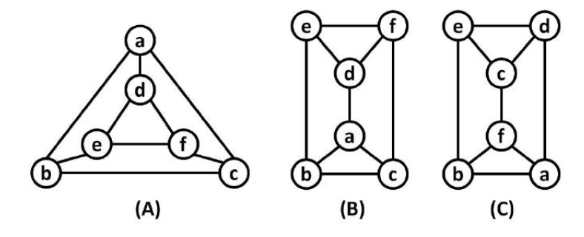
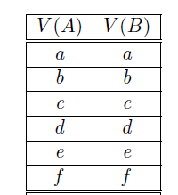
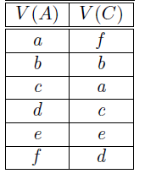
Prerequisite
NP Complete Problems.
Graph Isomorphism.
Graph Matching.
  Edit Distance
Sub Graph Isomorphism.
Graph Summarization
  Google Maps example
Graph Partitioning
  Cut Vertex
  Cut Edge
  Bipartite graph

Slide 13
Prerequisite….
Random Walk
Cliques
Planar & Non Planar Graphs.
Pattern Matching.
Disk Resident Graphs.
  Why the algorithms using random edges/nodes are not suitable for disk resident graphs
Graph Connectivity,
  Max Flow - Min Cut
Connected Components
  Largest Connected Components
Lowest common ancestor.
……

Slide 14
Topics for Assignments/Presentation
Graph Isomorphic algorithms
Diameter & Reachability calculation algorithm
Topic sensitive page rank algorithm
SimRank algorithm
Kerninghan-Lin algorithm & The Girvan-Newman Algorithm
gSpan Algorithm

Slide 15
Types of Graph Algorithms
The Graph algorithms are broadly classified in two different cases:
  Multiple graphs
    Chemical data
    Biological data
  Single Large Graph
    Web Graph
    Social media graphs

Slide 16
Quick recap
What is the difference between:
  A tree and a spanning tree?
  A spanning tree and Minimum spanning tree.
For what NP stands for and what does it mean?
What are disk resident graphs and what is its limitation, and why?

Slide 17
Various type of Data for Graph Mining
Search “image.Google” for various types of large graphs

Slide 18
Various type of Data for Graph Mining
Chemical Data: Often represented as graphs in which the nodes correspond to atoms, and the links correspond to bonds between the atoms.
  In some cases, substructures of the data may also be used as individual nodes.
  Such as Benzene rings
  Polymers
  The individual graphs are quite small, though there are significant repetitions among the different nodes. This leads to isomorphism challenges in applications such as graph matching.

Slide 19
Various type of Data for Graph Mining
Biological Data: Similar way as chemical data. However, the individual graphs are typically much larger. Furthermore, the nodes are typically carefully designed portions of the biological models
  Such as Proteins
    Amino acids
      A, T, G,C in DNA
      A, U, G, C in RNA
      Dominance and recessive property of Genes
        Mendel's experiment
A single biological network could easily contain thousands of nodes. The sizes of the overall database are also large enough for the underlying graphs to be disk-resident.

Slide 20
Various type of Data for Graph Mining
Computer Networked and Web Data: The number of nodes in the underlying graph may be massive as well as edges. (massive domain issue in networked data.)
    it may be hard to hold in the available storage space.
      So we need to be designed some techniques to summarize and work with condensed representations of the graph data sets.
        Google maps….
    The edges may also arrive in the form of a data stream.
      A new challenge arises, it may not be possible to store the incoming edges for future analysis.
      Therefore, the summarization techniques and the stream summaries may be leveraged for future processing of the underlying graphs.

Slide 21
Various type of Data for Graph Mining
XML data :Complex and semi-structured data is often represented in the form of XML documents
XML data is a natural form of labelled graph data.
Mining and management algorithms for XML data are also quite useful for graph data,
In addition, the attribute-value combinations associated with the nodes makes the problem much more challenging.
  Since it is much more difficult to design mining and management operations for structured data.

Slide 22
Application of Graph Mining

Slide 23
Application Of Graph Mining
The field of graph mining has seen a rapid explosion in recent years because of new applications in
  Computational biology
    Includes Bioinformatics.
    Is the science of using biological data to develop algorithms or models to understand biological systems and relationships

Slide 24
Computational biology (Subfields)
Computational anatomy
  A subfield of medical imaging (such as MRI) and bioengineering
Computational biomodeling
  Field concerned with building computer models of biological systems.
  Develop and use visual simulations in order to assess the complexity of biological systems.
  These models allow for prediction of how systems will react under different environments.
Computational genomics (Computational genetics)
  It is sometimes referred to as Computational and Statistical Genetics and encompasses much of Bioinformatics. The Human Genome Project is one example of computational genomics.
Source Wikipedia

Slide 25
Computational biology (Subfields).…
Computational neuroscience
  Computational neuroscience is the study of brain function in terms of the information processing properties
    Realistic Brain Models:
    Simplifying Brain Models:
Computational pharmacology
  the study of the effects of genomic data to find links between specific genotypes and diseases and then screening drug data
Computational evolutionary biology
  Using DNA data to reconstruct the tree of life with computational phylogenetics
  Fitting population genetics models (either forward time or backward time) to DNA data to make inferences about demographic or selective history.
Source Wikipedia

Slide 26
Computational biology (Subfields)….
Cancer computational biology
  Aims to determine the future mutations in cancer through an algorithmic approach to analyzing data.
Computational neuropsychiatry
  uses mathematical and computer-assisted modeling of brain mechanisms involved in mental disorders.
Source Wikipedia

Slide 27
Application Of Graph Mining
The field of graph mining has seen a rapid explosion in recent years because of new applications in
  Chemical data analysis (Structure Activity Relationship (SAR) principle)
    Behaviour of chemical compound,
      Property of any compound is based on its structural composition.
    Drug Discovery
      Thus, graph mining may help reveal chemical and biology characteristics to facilitate the process of drug design such as:
        activity, toxicity, absorption, metabolism, etc. [1],
[1] H.J. Bohm, G. Schneider. Virtual Screening for Bioactive Molecules. Wiley-VCH, 2000.

Slide 28
Application Of Graph Mining
The field of graph mining has seen a rapid explosion in recent years because of new applications in
  Chemical data analysis (Structure Activity Relationship (SAR) principle)
    Fundamental operations is similarity search for
      Rankretrieval: searching a large database to find chemical compounds that share the same bioactivity as a query compound;
      scaffold-hopping: finding compounds that have similar bioactivity but different structure from the query compound.

Slide 29
Application Of Graph Mining
The field of graph mining has seen a rapid explosion in recent years because of new applications in
  Chemical data analysis (Structure Activity Relationship (SAR) principle)
    Fundamental operations is similarity search
Identify compounds that are good “replacement” for the query compound, which either has some undesirable properties (e.g., toxicity), or is from the existing patented chemical space.
  Since chemical structure determines bioactivity (the SAR principle), scaffold- hopping is challenging, as the identified compounds must be structurally similar enough to demonstrate similar bioactivity, but different enough to be a novel chemotype.

Slide 30
Application Of Graph Mining
The field of graph mining has seen a rapid explosion in recent years because of new applications in
  Chemical data analysis (Structure Activity Relationship (SAR) principle)
Structure-driven prediction: to predict about any chemical based on its structure, i.e. active or inactive, toxic or nontoxic, etc.
  SVM (Support Vector Machines) based methods have proved effective for this task.
Target-based drug discovery: starts in late 1980's, Its goal is to develop a drug that selectively modulates the effects of the disease-associated gene or gene product without affecting other genes or molecular mechanisms in the organism. This is made possible by the High Throughput Screening (HTS) technique, which is able to rapidly testing a large number of compounds based on their binding activity against a given target.

Slide 31
Application Of Graph Mining
The field of graph mining has seen a rapid explosion in recent years because of new applications in
  Software bug localization
    is an important application from the perspective of software reliability and testing.
    The control flow of programs can be modelled in the form of call-graphs (CFD & DFD).
    The goal of software bug localization techniques is to mine such call graphs in order to determine the bugs in the underlying programs.
    Call graphs are of two types:
      Static call graphs
      Dynamic call graphs

Slide 32
Application Of Graph Mining
The field of graph mining has seen a rapid explosion in recent years because of new applications in
  Software bug localization
    Static call graphs can be inferred from the source code of a given program. All the methods, procedures and functions in the program are nodes, and the relationships between the different methods are defined as edges.
    Dynamic call graphs are created during program execution, and they represent the invocation structure.
    Such call graphs can be extremely large in massive software programs, because of thousands of invocations between different procedures. In such cases, the difference in structural, frequency or sequence behaviour of successful and failing invocations can be used to localize software bugs.
    Such call graphs can be particularly useful in localizing bugs which are occasional in nature and may occur in some invocations and not others.

Slide 33
Application Of Graph Mining
The field of graph mining has seen a rapid explosion in recent years because of new applications in
  Software bug localization
    Logical errors in a program which are not a result of the program structure, and which do not affect the sequence or structure of execution of the different methods cannot be localized with such techniques.
    software bug localization is not an exact science. Rather, it can be used in order to provide software testing experts with possible bugs, and they can use this in order to make relevant corrections.

Slide 34
Application Of Graph Mining
The field of graph mining has seen a rapid explosion in recent years because of new applications in
  Social and Communication networking
    The World Wide Web (WWW) is naturally structured in the form of a graph with nodes as web pages and the links are the edges.
    The linkage structure of the web holds a wealth of information which can be exploited for a variety of data mining purposes.
    The most famous application which exploits the linkage structure of the web is the PageRank algorithm.
    This algorithm has been one of the key secrets to the success of the well known Google search engine.

Slide 35
Application Of Graph Mining
The field of graph mining has seen a rapid explosion in recent years because of new applications in
  Social and Communication networking
    PageRank algorithm.
      The basic idea is that the importance of a page on the web can be gauged from the number and importance of the hyperlinks pointing to it.
      The intuitive interpretation of page rank is the probability that a random surfer arrives at a given web page during a random walk.
      Thus, it forms a probability distribution over web pages, so that the sum of the page rank over all the web pages sums to 1, with teleportation, in which we can transition any web page in the collection uniformly at random.

Slide 36
Application Of Graph Mining
The field of graph mining has seen a rapid explosion in recent years because of new applications in
  Social and Communication networking
    PageRank algorithm.
      The page-rank algorithm only looks at the link structure during the ranking process, and does not include any information about the content of the underlying web pages.
      A closely related concept is that of topic-sensitive page rank [2], in which we use the topics of the web pages during the ranking process.
      Page rank is inherently a dynamic problem.
[2] T. Haveliwala. Topic-Sensitive Page Rank, World Wide Web Conference, 2002.

Slide 37
Application Of Graph Mining
The field of graph mining has seen a rapid explosion in recent years because of new applications in
  Social and Communication networking
  Social networks are very large graphs which are defined by people who appear as nodes, and links which correspond to communications or relationships between these different people. The links in the social network can be used to
    Determine relevant communities
    Members with particular expertise sets, and
    The flow of information in the social network.

Slide 38
Application Of Graph Mining
The field of graph mining has seen a rapid explosion in recent years because of new applications in
  Social and Communication networking
  Social networks are very large graphs which are defined by people who appear as nodes, and links which correspond to communications or relationships between these different people. The links in the social network can be used to
    Determine relevant communities
      It is related to the problem of node clustering of very large graphs.
      It is particularly interesting in the context of dynamic analysis of evolving networks in which we try to determine how the communities in the graph may change over time.
      newly forming communities, decaying communities, or evolving communities.

Slide 39
Application Of Graph Mining
Members with particular expertise sets, &The flow of information in the social network
  Centrality analysis in networks is closely related to the problem of information flow spread in social networks.
    To determine the most influential members of the social network;
    Information in the social behaviour often cascades through it in the same way as an epidemic. We would like to measure the information cascade rate through the social network, and determine the effect of different sources of information.

Slide 40
Reference
D. Cook, L. Holder, Mining Graph Data, John Wiley & Sons Inc, 2007.
Agarwal Charu C. and Wang Haixun, “Managing and Mining Graph Data”, 2010.

Slide 41
Thank You

